Slide 1
Introduction to FHIR
David Hay
May 11, 2015

Slide 2
This presentation
Can be downloaded here:
http://gforge.hl7.org/svn/fhir/trunk/presentations/2015-04 Tutorials/Introduction to FHIR.pptx
Use “anonymous” and email address to logon
Is licensed for use under the Creative Commons, specifically:
Creative Commons Attribution 3.0 Unported License
(Do with it as you wish, so long as you give credit)

Slide 3

Who am I?
Name: David Hay
Company: Orion Health
Background:
Involved in FHIR almost from beginning
Ex Clinician
Co-Chair FHIR Management Group
Chair HL7 New Zealand
Blog: FHIRBlog.com

Slide 4
Who are you?
What’s your background with HL7?
v2? v3? CDA? Brand new?
What’s your role?
Developer? Manager? Clinician? Other?
What’s the single most important thing for you to get out of today’s course?
Please be brief!

Slide 5
Tutorial Objectives
You should:
Know where FHIR fits in the broader healthcare landscape, including other HL7 specifications
Be able to explain what FHIR is to others in your organization, and what impact it might have
Be equipped to help your organization determine if, when, where and how you might use FHIR
Know how to approach the FHIR specification to find out what more you need to know
Be prepared for the more detailed tutorials
Be able to engage with the community
Notes:
9:15

Slide 6
What is FHIR?
DSTU 2

Slide 7

Answer: An instigator of bad puns
FHIR is the hottest thing since . . .
This spec is spreading like wild. . .
This company is really on FHIR
Feel free to come up with your own
(but please, not here ☺)

Slide 8
The acronym
F – Fast (to design & to implement)
Relative – No technology can make integration as fast as we’d like
H – Health
That’s why we’re here
I – Interoperable
Ditto
R – Resources
Building blocks – more on these to follow
Notes:
9:25

Slide 9
Genesis of FHIR
Has been a need to share healthcare information electronically for a long time
Increasing pressure to broaden scope of sharing
Across organizations, disciplines, even borders
Mobile, Device & Cloud-based applications
Faster – integration in days or weeks, not months or years
Notes:
v2 is over 25 years old

Slide 10
Genesis of FHIR
Q: So what did HL7 have to offer in this space?
A: Not much
V2 old, and limited by it’s own rules (though hugely successful)
V3 too slow and too hard
CDA has success, but both limited and too hard
Different contexts of interoperability → different representations that aren’t compatible
Nothing suitable for light-weight integration, or for Health 2.0

Slide 11

Genesis of FHIR
HL7 undertook a “Fresh look”
What would healthcare exchange look like if we started from scratch using modern approaches?
Web search for success markers led to RESTful based APIs
Exemplar: Highrise (https://github.com/37signals/highrise-api)
Drafted a healthcare exchange API based on this approach

Slide 12
Timeline: Where does FHIR fit?
V2
1987
Start V3
1995
V3
CDA
2005
Fresh
Look
2011
FHIR
DSTU
2014
10 years
3
years
1980
1990
2000
2010
2020

Slide 13
FHIR Principles

Slide 14
FHIR Manifesto
Focus on Implementers
Target support for common scenarios
Leverage cross-industry web technologies
Support human readability as base level of interoperability
Make content freely available
Support multiple paradigms & architectures
Demonstrate best practice governance
Notes:
We don’t actually have a formal manifesto, but these are the principles we adhere to.

Slide 15
Implementer Focus
Specification is written for one target audience: implementers
Rationale, modeling approaches, etc. kept elsewhere
Multiple reference implementations from day 1
Publicly available test servers
Starter APIs published with spec
C#, Java, Pascal, ObjectiveC, Javascript
more to come
Connectathons to verify specification approaches
Instances you can read and understand ☺
Lots of examples (and they’re valid too)
using HL7.Fhir.Instance.Model;
using HL7.Fhir.Instance.Parsers;
using HL7.Fhir.Instance.Support;
XmlReader xr = XmlReader.Create(
new StreamRead
IFhirReader r = new XmlFhirReader
// JsonTextReader jr = new JsonTe
// new StreamRead
// IFhirReader r = new JsonFhirRe
ErrorList errors = new ErrorList(
LabReport rep = (LabReport)Resour
Assert.IsTrue(errors.Count() == 0
Notes:
Who’s read the v3 spec? – modeler & balloter focused
Spec is driven by people who write code
Numerous pieces have been changed because of experience with what worked when trying to implement
Even have a test workbench for RESTful servers
External libraries already available
Whole spec is built like software project

Slide 16
Support “Common” Scenarios
Focus on scenarios implementers ask for
Inclusion of content in core specification is based on core content rule
“We only include data elements if we are confident that most normal implementations using that resource will make use of the element” (80%)
Other content in extensions (more on this later)
Easy to say, governance challenge to achieve
Resources are simple and easy to understand and use
Notes:
Design by constraint failed – years to develop, what was produced required yet more design to be implementable and after that might not be interoperable
How to determine the 80%? Look to existing specs – v2, v3, CDA templates, OpenEHR, jurisdictional projects, what implementations we’ve seen
If not sure, err on the side of “not in for now”
Note: not 80% of instances, 80% of implementations
Challenges with “raising the bar”
What happens when there aren’t many/any implementations?

Slide 17
Web technologies
DSTU 2
HTTP
DataTypes W3C complaint
Instances shared using XML or JSON
REST supported
Web calls work the same way they do for Google, Facebook & Twitter
Rely on HTTPS, OAuth, etc. for security functions
Atom was used for bundles
Replaced in DSTU-2
Notes:
We try very hard to *not* invent stuff that exists elsewhere unless it’s really broken or totally unaligned with the FHIR principles.

Slide 18

Human Readable
CDA has both narrative and data
The data / narrative dynamic exists throughout the process
In FHIR, every resource should have a human-readable expression
Can be direct rendering or human entered
Notes:
Even when you think your target will understand all the encoded data, reality is data often gets shared beyond the originally intended context
Allow for exceptions for things like automated device readings, etc.

Slide 19
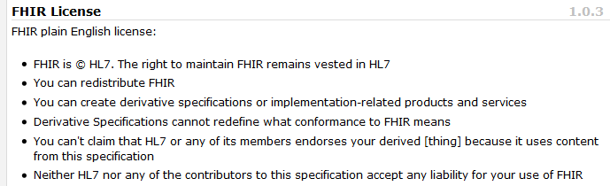
Freely available
Unencumbered – free for use, no membership required
http://hl7.org/fhir
Notes:
Was a bigger deal before HL7 decided to open up all IP
full legal text towards bottom of FHIR home page

Slide 20
Paradigms and Architectures
Notes:
9:45

Slide 21
Paradigms
FHIR supports 4 interoperability paradigms
REST
Documents
Messages
Services

Slide 22
REST
“Representational state transfer” – an architecture for how to connect systems
CRUD
Outcomes
Simple stable interfaces
High Performance / Scalability
Visible Process (e.g. can debug)
Portability
Reliability (resistance to failure)

Slide 23
Document
DSTU 2
Bundle
Similar to CDA
Collection of resources bound together
Root is a “Composition” resource
Just like CDA header
Sent as part of Bundle
One context
Can be signed, authenticated, etc.
Composition
Resource 1
Resource 2

Slide 24
Message
DSTU 2
Similar to v2 and v3 messaging
Also a collection of resources as a Bundle
Allows request/response behavior with bundles for both request and response
Event-driven
E.g. Send lab order, get back result
Can be asynchronous
Bundle
MessageHeader
Resource 1
Resource 2
Notes:
10:30

Slide 25
Service Oriented Architecture (SOA)
Do whatever you like
(based on SOA principles)
Ultra complex workflows
Ultra simple workflows
Individual resources or collections (in Bundle or other formats)
Use HTTP/S or use something else
Only constraint is that you’re passing around FHIR resources in some shape or manner
Services
Notes:
Comment about SOA discovery day

Slide 26
Operations
DSTU 2
RPC in REST
Examples in spec
Get Patient record
Expand ValueSet
Fetch Encounter data
Resources that define Input & Output

Slide 27

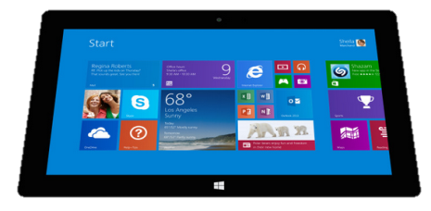
Regardless of paradigm
the content is the same
Receive a lab result in a message…
FHIR
Repository
FHIR Message
FHIR Document
Lab System
REST
National
Exchange
…Package it in a discharge summary document

Slide 28
Governance
Oversight
TSC
Governance
FGB
Methodology
MnM
Management
FMG
Content
Core Team
Content
Work Groups
Notes:
FHIR Governance Board
Maintains FHIR principles
Identifies risks, precepts
Handles coordination w/ external groups
FHIR Management Group
Coordinates Work Groups
Manages ballot process
Education delivery
Day-to-day activities
Modeling & Methodology
Defines criteria for artifacts
Determines processes
Documents best practices
Work Groups
Do the actual development work
Core Team
Temporary
Takes on work Work Groups can’t
Expedites
What haven’t we talked about yet?

Slide 29
Architectures
FHIR makes no assumptions about the architectural design of systems
You can use it for
Light or heavy clients
Central server or peer-to-peer sharing
Push or pull
Query or publish/subscribe
Loosely coupled or tightly coupled environments
With history tracking (versions) or without
Notes:
More on this later…

Slide 30
Reading the FHIR Spec

Slide 31
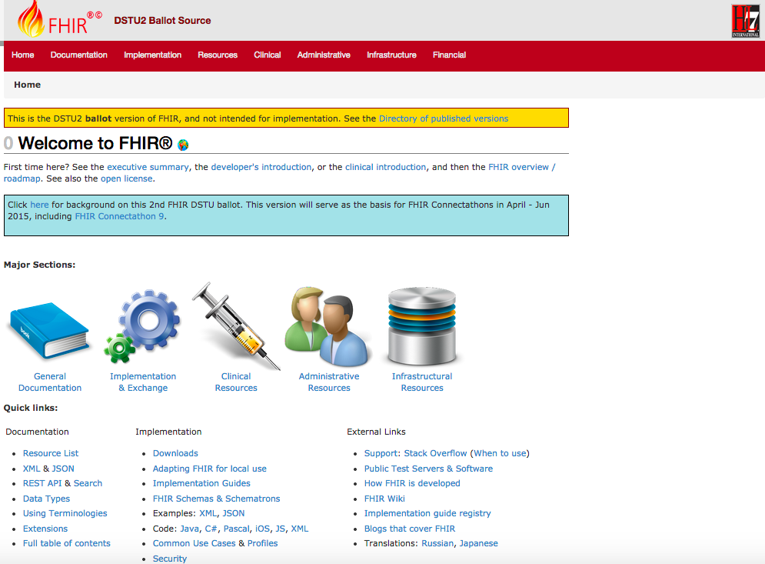
DSTU 2
DSTU-2
Notes:
Published as HTML
Published using validation process that performs consistency checks – like a software build
Really shouldn’t require much guidance to read, but a few things to call out
Objective of spec is developer can skim and decide in < day

Slide 32
FHIR Resources
Notes:
10:00

Slide 33

Resources
“Resources” are:
Small logically discrete units of exchange
Defined behaviour and meaning
Known identity / location
Smallest unit of transaction “of interest” to healthcare
V2: Sort of like Segments
V3: Sort of like CMETs

Slide 34
What’s a Resource?
Examples
Non-examples
Administrative
Patient, Practitioner, Organization, Location, Coverage, Invoice
Clinical Concepts
Allergy, Condition, Family History, Care Plan
Infrastructure
Document, Message, Profile, Conformance
Gender
Too small
Electronic Health Record
Too big
Blood Pressure
Too specific
Intervention
Too broad
100-150 total
Notes:
And few systems will ever see more than 40-50

Slide 35
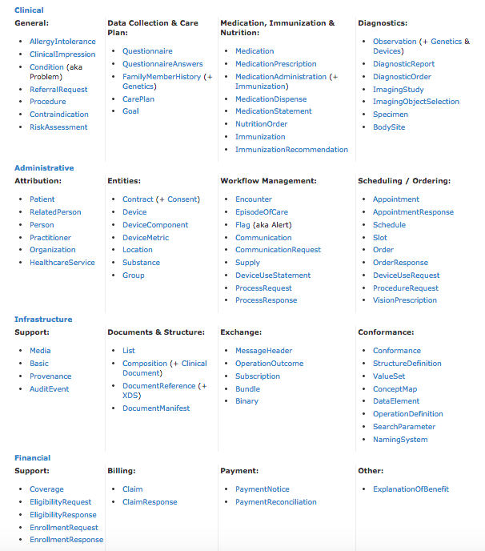
Resources
DSTU 2

Slide 36
Resource anatomy
DSTU 2
Resources have 4 parts
Metadata
Narrative
(text)
Extensions
Defined
Structured
Data
Notes:
Defined Structured Data
The logical, common contents of the resource
Mapped to formal definitions/RIM & other formats
Extensions
“Non-common” requirements, but everyone can use
Published and managed
Narrative
Human readable (fall back)

Slide 37
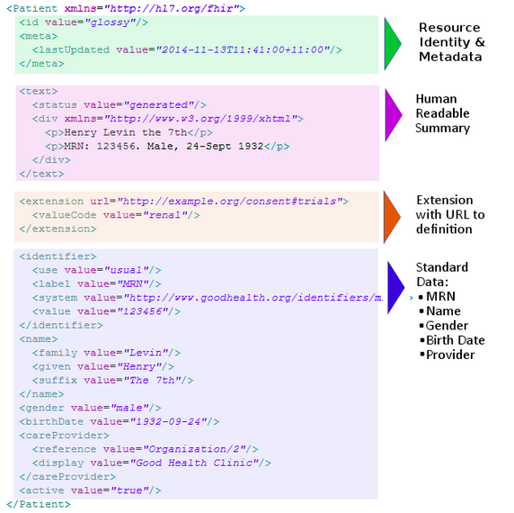

Slide 38

Structure of a Resource
DSTU 2
Resource
Narrative
Elements
Metadata
Extensions
Extensions

Slide 39
Resource Documentation
For each Resource:
Scope and Usage Notes
Resource Content (UML and XML)
Terminology Bindings
Constraints
Implementation Issues
Search Parameters
Examples, Profiles, Formal Definitions
Mappings to RIM, CDA, v2, etc

Slide 40
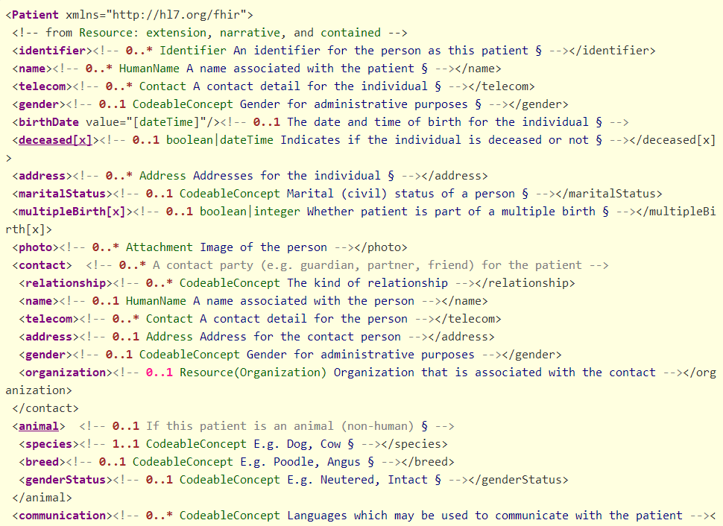

Slide 41
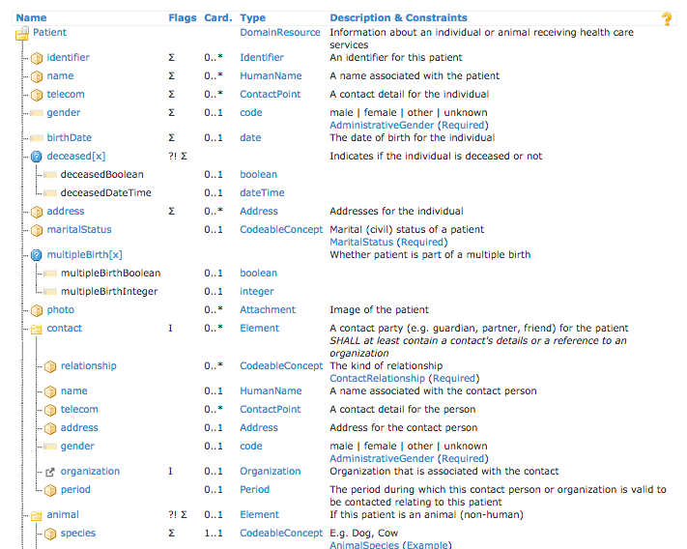
DSTU 2

Slide 42
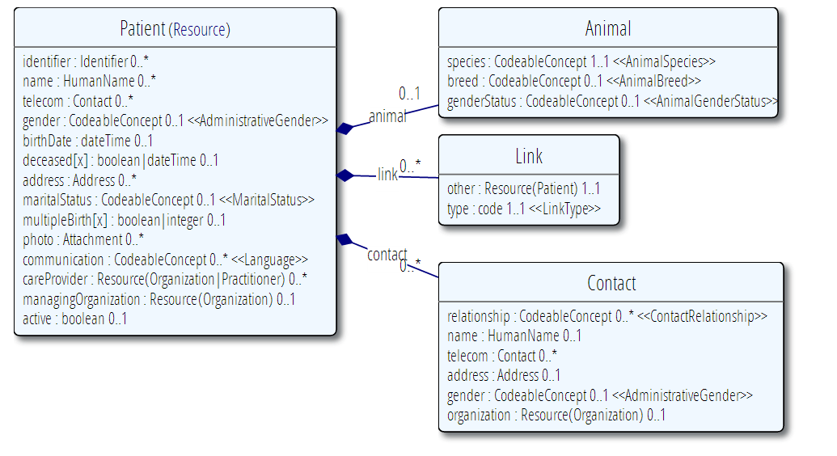
Example Resource Definitions

Slide 43
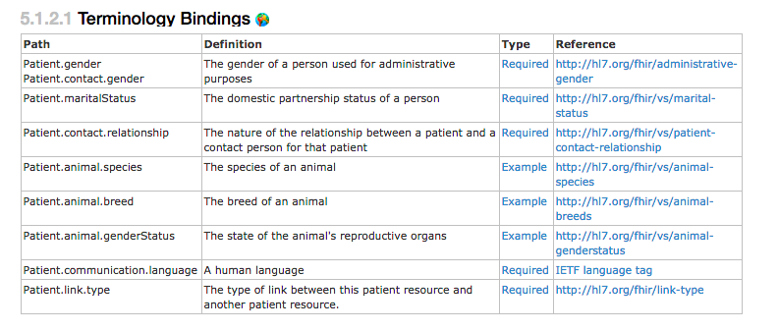
Bindings
For coded elements

Slide 44
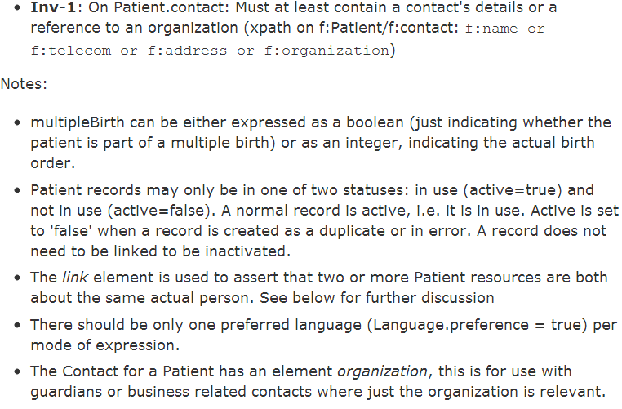
Constraints & Notes

Slide 45
Identity
2 different ‘sorts’ of identity
ID identifies a resource on a server
Is metadata
Will change between servers
Identifier
Business identifier
Is an element in the resource

Slide 46
A Resource’s ID
http://server.org/fhir/Patient/1
resource type
endpoint
id
Note: This URL resolves to the current version of a resource
It’s also specific to a server
Notes:
This is not only the URL you use to retrieve the resource, it’s also its id.
All URL’s in FHIR are case-sensitive (and so is the id)

Slide 47
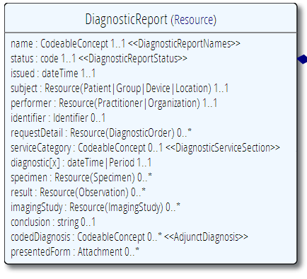
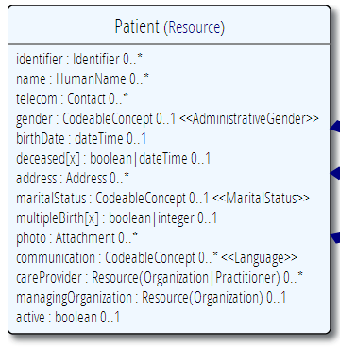
“Business” identifiers
Notes:
Resource Id’s (=URLs) are infrastructural id’s, they differ from “business” identifier.
Many Resources also have business identifiers, they are explicitly modeled, like Patient.identifier (even more than one identifier possible!)
Business identifiers are completely separate from technical resource id’s

Slide 48
It’s all about combining resources . . .
http://lab.hospitalA.org/Observation/3ff27
http://moh.govt.nz/nhi/Patient/223
Observation
Patient
Diagnostic
Report
Organization
http://lab.hospitalA.org/DiagRep/4445
Practitioner
http://moh.govt.nz/hpi/Organization/1
http://moh.govt.nz/hpi/Practitioner/87

Slide 49
References
Resources are independent – don’t need other resources to correctly interpret a resource
But resources reference each other extensively to form a web of information
Need to resolve references to fully understand the data
<Procedure xmlns="http://hl7.org/fhir">
<subject>
<reference value="Patient/23"/>
</subject>
…
<report>
<reference value=”http://myServer/DiagnosticReport/45"/>
</report>
…

Slide 50
Rules for references
References can be relative or absolute
References don’t have to be to the same server
Server does not have to enforce integrity
Clients need to cater for broken links
Targets can be ‘contained’ in the resource:
<Procedure xmlns="http://hl7.org/fhir">
<contained>
<Patient id="pat">
</Patient>
</contained>
<subject>
<reference value="#pat"/>
</subject>

Slide 51
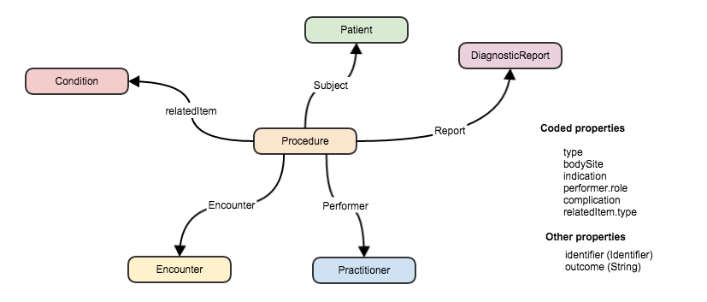
References between resources

Slide 52
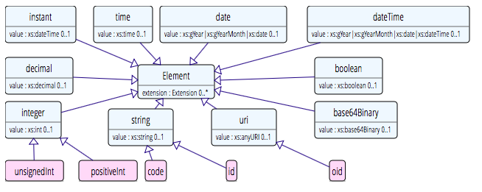
Data types:Primative
Based on w3c schema and ISO data types
Stick to the “80% rule” – only expose what most will use
Simplified

Slide 53
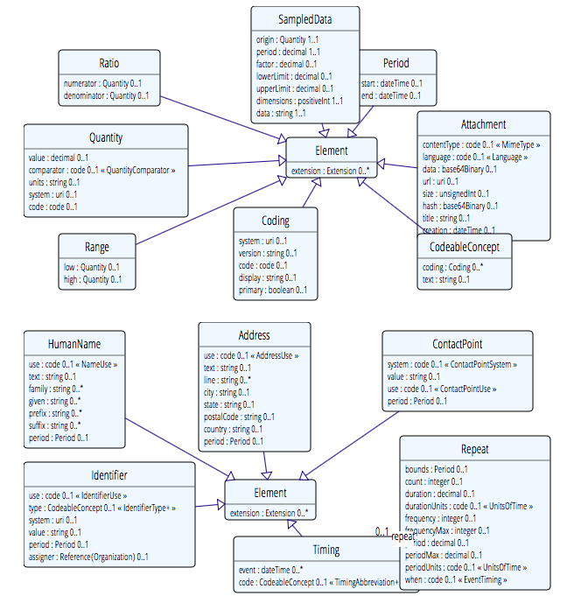
Complex
DSTU 2

Slide 54
Example – CD datatype
ISO
Code, code system, code system name, code system version, value set id, value set version, coding rationale, updateMode, flavorId, nullFlavor, controlAct root & extension, validTime low and high
displayName with language and translations
originalText with mediaType, language, compression, integrityCheck, thumbnail, description, translations, reference (can be text, video, whatever)
Translations (most of same info as code)
Source code

Slide 55
Example – CD datatype
FHIR
Code, code system, code system name, code system version, value set id, value set version coding rationale, updateMode, flavorId, nullFlavor, controlAct root & extension, validTime low and high
displayName with language and translations
originalText with mediaType, language, compression, integrityCheck, thumbnail, description, translations, reference (can be text, video, whatever)
Translations (most of same info as code)
Source code

Slide 56
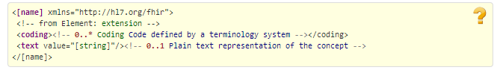
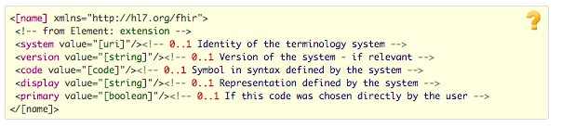
CodeableConcept
CodeableConcept
Coding

Slide 57
Vocabulary
Support for coded data of varying complexity
Some codes defined as part of resource, others referenced from external vocabularies
LOINC, SNOMED, UCUM, etc.
Recognition some will differ by implementation space
Can use Value Set resource to define more complex or specific code lists

Slide 58
Narrative
All resources can carry an html representation of their content
It’s a clinical safety issue
The receiver has a fall back option if the system is not sure it fully understands the content
It is not mandatory, but SHOULD be present
In a closed eco-system, with extremely tight control and strong conformance testing, it may not be necessary
But things often change over time
So using narrative is highly recommended
Notes:
Saves a lot of money downstream from the author

Slide 59
Narrative XHTML
Narrative is XHTML. Formatting allowed:
Tables, lists, divs, spans
Bold, Italics, styles etc
E.g. all static content
Features not allowed:
Objects, scripts, forms – no active content
Links, Stylesheets, iframes – web context
Local storage, Microdata (no active content)
Concerns are security and clinical safety

Slide 60
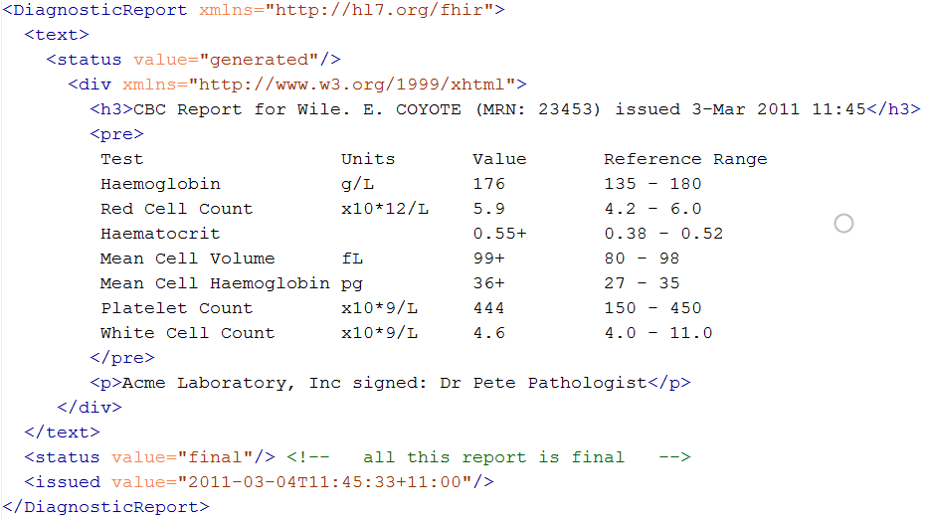
Narrative example
Notes:
Resources SHOULD always contain narrative to support human-consumption as a fallback. However, in a strictly managed trading systems where all systems share a common data model and additional text is unnecessary or even a clinical safety risk, the narrative may be omitted.
generated The contents of the narrative are entirely generated from the structured data in the resource.
extensions The contents of the narrative are entirely generated from the structured data in the resource and some of the content is generated from extensions.
additional The contents of the narrative contain additional information not found in the structured data.
empty the contents of the narrative are some equivalent of "No human-readable text provided for this resource".

Slide 61
FHIR Extensions
Notes:
10:15

Slide 62
The Case for Extensions
Extensions are often problematic in existing HL7 specs
Z-segments in v2
What does this mean?
ZSB|20080117|Q^57|4.30^uL
Foreign namespaces in CDA/V3
Break schemas
Simple choice – design for absolutely everything or allow extensions

Slide 63
Extensions
FHIR has a standard framework for extensions
Built into wire format
Every FHIR element can be extended
Including datatypes
Every extension has:
Reference to a computable definition
Value – from a set of known types
Every system can read, write, store and exchange all legal extensions
All extensions are valid by schema etc.

Slide 64
Extensions
In FHIR, extensions are “normal”
Consequence of the 80% rule – keep the simple stuff simple
Extensions can exist anywhere
Resource, Element, DataType
Conformant systems can’t reject instances just because they contain unrecognized extensions
They could:
Display them
Should be in resource narrative
Store as a ‘Blob’
Make a conscious decision to ignore (unless ModifierExtension)
(Could lookup profile)
Notes:
[31/08/14 3:34:55 pm] Lloyd McKenzie: no. They can't refuse the instance because it contains extensions (unless they're modifierExtensions), but they're free to strip/ignore them.
[31/08/14 3:35:19 pm] Lloyd McKenzie: Requiring persistance would cause havoc with legacy systems

Slide 65
Extension Definition
DSTU 2
Core part of profiling
(to come later)
A separate resource (was part of profile)
StructureDefinition
Also used for resource definition
Registries
Search before build
Promote reuse

Slide 66
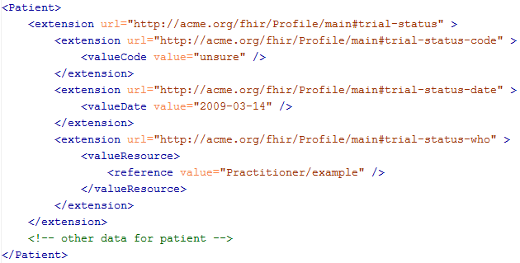
An Extension in a resource

Slide 67
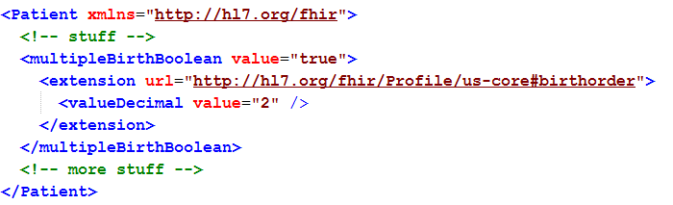
Extending a multiple birth
Key = location of formal definition
Value = value according to definition
Notes:
Really any FHIR element (Resource, Datatype, Primitive) can be extended. Just nest an <extension> element under the thing you want to extend
You should be able to go to the formal definition endpoint and get the definition of the extension.
Note: birth order is already provided for in FHIR through the multipleBirthInteger

Slide 68
Modifier Extensions
Also a core part of FHIR
Needed because some extensions can’t be safely ignored
Can’t compute on an element containing an unrecognized modifier extension. However, can:
Reject instance
Just display narrative
Retrieve definition & seek human review

Slide 69
Governing Extensions
Extensions are not a silver bullet
FHIR has a sliding scale governance for extensions
HL7 published extensions
National Standards (e.g. Standard Finnish Extensions)
Domain standards (e.g. Best Practice Cardiology)
Local Projects

Slide 70
resource misc.
Notes:
10:15

Slide 71
Tags
DSTU 2
Contain metadata about resources
Beyond ID, version & date
Used for different purposes:
Compliance to Profile
Security – e.g. sensitivity of resource
Indicate Document/Message
User defined
Transported in different ways:
REST – as an HTTP header
In a bundle (document, message, transaction) - in the metadata element of the resource or the bundle

Slide 72
Versioning
Most recent version
http://server.org/fhir/Patient/1
Returns single resource
All versions
http://server.org/fhir/Patient/1/_history
Returns bundle of versions
Specific version
http://server.org/fhir/Patient/1/_history/1
Returns single resource
Version support is optional
Notes:
Works at instance and type level – originally there

Slide 73
Version history - revival
33, v13 – 2012-12-05
/server.org/fhir/Patient/33/_history/13
33, v14 – 2012-12-08
/server.org/fhir/Patient/33/_history/14
33, v15 – 2012-12-09
/server.org/fhir/Patient/33/_history/15
33, v16 – 2012-12-10
/server.org/fhir/Patient/33/_history/16
33, v17 – 2012-12-11
/server.org/fhir/Patient/33/_history/17
/server.org/fhir/Patient/33
Notes:
* The resource returns back to life!

Slide 74
Bundles
DSTU 2
When more than one resource needed
Query result
Document
Message
Transaction
Specific Resource
Was “Atom feed” with JSON representation

Slide 75
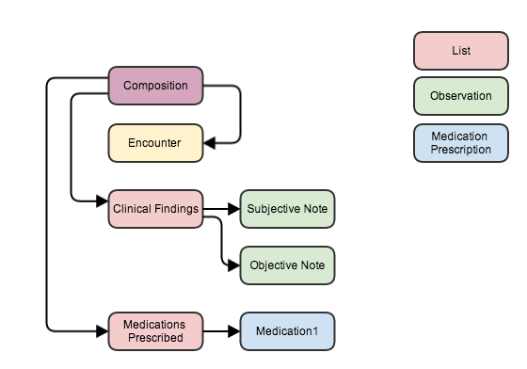
Bundle as a serialized Object Graph
Notes:
Imagine that all resources in a single bundle
Links maintain references
Comment on new recources (cid: id’s)

Slide 76
About REST and Resources
Notes:
Because REST was the biggest need and the most currently worked out…

Slide 77
REST in practice
“Resources” with an explicit and stable URI
The name for what gets exchanged in REST
Defined behaviour and meaning
Known identity / location
Quite an abstract idea
Formats: XML / JSON / RDF
Exchange using HTTP
Security: SSL / OAuth
“REST” followed loosely, hence “RESTful”

Slide 78
REST Activities
CRUD:
Create – create a new instance of data
Read – get the content (state) of an instance of data
Update – change the content of an instance of data
Delete – remove the instance of data
Notes:
Delete isn’t necessarily physical
Execute – eg transaction

Slide 79
RPC vs REST
DSTU 2
RPC (Remote Procedure Call):
Ask a server to perform some operation
Hand it a set of parameters
Server performs some operations
Returns a set of parameters
REST:
Define a URI that represents the state of something
Tell the server what the state should be
Server makes the state change happen

Slide 80
RPC vs REST example
Example:
A device that monitors a patient %0₂ Sat
Raises an alarm on EHR if it’s too low
EHR can turn the alarm off
RPC:
POST http://acme.org/devices/turnOffAlarm
Parameters: device id, alarm id
REST:
POST http://acme.org/devices/[deviceid]/[alarmid]
Content: data to say “Alarm is off”

Slide 81
FHIR Activities
(Based on CRUD REST – not Operations)

Slide 82
Business Processes
Register a patient:
Create a Patient Resource
Admit a patient:
Create an Encounter Resource
Move a patient from one bed to another
Find and update the encounter resource
Prepare a list of medications to administer
Search through the medication prescriptions for a patient (and then apply logic)
Or, use a List resource
Notes:
Note relation to v2 messaging

Slide 83
FHIR Resource URLs
Template | Description | Example
[base] | Server URL | http://fhir.com
[base]/[type] | URL for type manager | http://fhir.com/Patient
[base]/[type]/[id] | URL for a resource | http://fhir.com/Patient/23
[base]/[type]/[id]/_history/[vid] | URL for a past version of a resource | http://fhir.com/Patient/23/_history/2

Slide 84
Activity/ Type
Activity | Description | Request Content | Response Content
create | Create a new resource with a server assigned id | Resource | --
search | Search through all resources of the type based on some filter criteria | Params | Bundle
history | Get a list of all the past versions of this resource type | -- | Bundle
validate | Check that the content would be acceptable as an update | Resource | Resource (OperationOutcome)

Slide 85
Activity/ Instance
Activity | Description | Request Content | Response Content
read | Read the current state of the resource | -- | Resource
vread | Read the state of a specific version of the resource (e.g. what it was in the past) | -- | Resource
update | Update an existing resource by its id (or create it if it is new). Use the resource representation supplied | Resource | --
delete | Remove the resource so it is no longer present (note: it still has a history) | -- | --
history | Get a list of all the past versions of the resource | -- | Bundle

Slide 86
Activity/ System
Activity | Description | Request Content | Response Content
conformance | Get a conformance statement for the system | -- | Resource
transaction | Update, create or delete a set of resources as a single transaction | Bundle | Bundle
history | Retrieve the update history for all resources (full pub/sub) | -- | Bundle
search | Search through all resources of all types based on some filter criteria | Params | Bundle

Slide 87
Playing with FHIR
DSTU 2
Access public server
Notes:
Sample CRUD stuff
Search for patient on name
Specify json or xml
Get a patient
Update a patient
Grahames & Ewouts server

Slide 88
Profiles & conformance
DSTU 2
Notes:
10:15

Slide 89
The need for Profiles
Many different contexts in healthcare, but a single set of Resources
Need to be able to describe restrictions based on use and context
Allow for these usage statements to:
Authored in a structured manner
Published in a repository
Used as the basis for validation, code, report and UI generation.
Note Profiling is going to be very important
‘Message from the chair’

Slide 90
The need for Profiles
Profiles can serve the same purpose as:
CDA templates & implementation guides
HL7 v2 “static” profiles
CIMI implementation guides
OpenEHR Archetypes & templates
Profiles aren’t mandatory for interoperability, but they improve the degree of it.
Profiles never change meaning of an instance

Slide 91
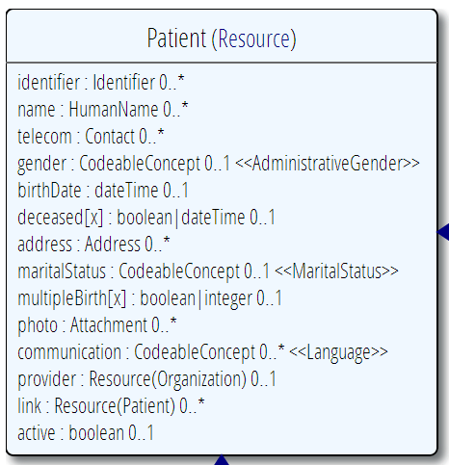
Profiling a resource. For example...
Require that the identifier uses the NHI – and is required
Limit names to just 1 (instead of 0..*)
Limit maritalStatus to another set of codes that extends the one from HL7 international
Add an extension to support “Iwi”
Note: hardly any mandatory elements in the core spec!

Slide 92
Using Profiles
You can just go ahead and use a resource
No need for a profile
But you should write a profile
Document your usage in detail for partners
You can mark a resource or bundle with a profile
It’s just a claim – can test conformance with that
Notes:
Denormalization for performance
Comment that profiles will be really important

Slide 93
Conformance
There’s a resource for documenting conformance to FHIR
Can be used for:
Stating how a specific system instance behaves
Defining how a software system is capable of behaving (including configuration options)
Identifying a desired set of behavior (e.g. RFP)
To declare themselves “FHIR Conformant”, a system must publish a Conformance instance
Notes:
Doesn’t have to support XML – is can be json only

Slide 94
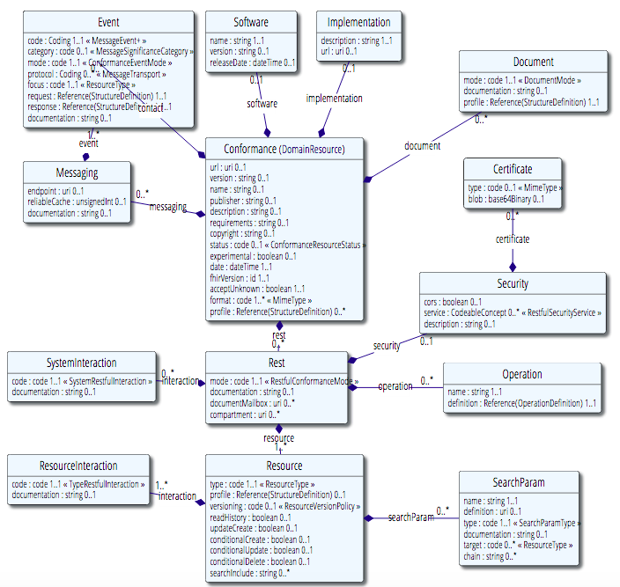
Conformance (cont’d)

Slide 95
Implementing FHIR

Slide 96
Where can FHIR be used?
Classic in-institution interoperability
Back-end e-business systems (e.g. financial)
Regional Health Information Organizations (RHIO)
National EHR systems
Social Web (Health)
Mobile Applications
Near
Term

Slide 97
Architecture
Standalone FHIR Server
A FHIR Server in front of an existing application (e.g. SQL)
FHIR as front end to an XDS server (“MHD”)
An interface engine that ‘speaks’ FHIR
A tablet/mobile phone application
Web portal uses FHIR to access other systems
A healthcare application that access information from multiple systems as well as it’s own server
Smart-On-FHIR – an EHR plug-in framework

Slide 98
Implementation Assistance
Reference Implementations – object models, parsers, serializers, clients, validators, utilities
Schema, Schematron, Validation Pack
1000’s of examples
Live Servers to test against
http://wiki.hl7.org/index.php?title=Publicly_Available_FHIR_Servers_for_testing
Connectathons

Slide 99
Servers
Use the servers to explore how it works
Write clients that use the test data
Test that you got your own system right
Most developers:
Use the servers to learn
Consult the documentation occasionally
We do recommend to read the specification
(RTFS)

Slide 100
Other Free software
See http://wiki.hl7.org/index.php?title=Open_Source_FHIR_implementations
Coming shortly:
“Sprinkler” – a conformance test tool for servers
“Forge” – an editor for conformance statements
A Value set Editor
Several implementation guide publishers

Slide 101
Connectathons
Open invitation to any interested party to come and write software that exchanges FHIR resources
Always hold one before HL7 meetings (last week) + Others by invitation
Mix of skills
Newbies (“where is the spec?”)
Old hands who’ve been to every connectathon
Experiment with new features
We have a virtual connectathon all the time…

Slide 102
Implementation Assistance
Stack Overflow – ask implementation questions
Link from front page
Search for answers first
Don’t ask for changes to the spec (get deleted!)
gForge Tracker – ask for changes to the spec
Link from bottom of every page
But have discussion somewhere first
Disqus – on every page of the specification
Skype – implementers channel – 251 participants
FHIR Email list, Connectathons, Tutorials

Slide 103
Migration
No expectation that people will migrate existing interfaces any time soon.
Initial adopters will be green-field, new technology
FHIR may see use behind the scenes in v2 systems before it sees use over the wire
Forthcoming policy initiatives may necessitate revisiting existing interfaces

Slide 104
Migration – v2
Already have at least one integration engine that supports translation between v2 and FHIR
Resources map to segments reasonably well
As always, the challenge with v2 mapping is the variability of v2 interfaces
“Common” mappings can be created, but they won’t be one size fits all
Focus of Connectathon this time

Slide 105
Migration – CDA
DSTU 2
Made more complex by human-readable nature
Need to ensure text <-> entry linkages are retained
Will best be handled on a template by template basis
Start with well defined ones like C-CDA
Argonaut
Notes:
12:15
Text linkages not as important when not human-attested

Slide 106
What’s next?

Slide 107
Development plans
Performing rigorous QA on initial set of resources
Full support for C-CDA in next DSTU
Additional resources will continue to be introduced in future DSTU cycles as implementers identify needs
Continue to seek testing & real world implementation experience

Slide 108
Balloting plans
First Draft Standard for Trial Use ballot (DSTU) complete
DSTU publication in Jan 2014
Will provide a semi-stable platform for implementers while still allowing non-backward-compatible change for Normative version if implementation experience dictates
Additional DSTU versions roughly annually to make fixes, introduce new resources
Normative is around 2.5 years out
We want *lots* of implementation experience before committing to backward compatibility

Slide 109

Next Steps for you
Attend the other FHIR tutorials
Architects, Developers, Profiles
Read the spec: http://hl7.org/fhir
Comment on the spec (link on each page)
Follow #FHIR on Twitter
Shape the specification:
Join the FHIR track at this WGM
Join the FHIR email list http://wiki.hl7.org/index.php?title=FHIR_email_list_subscription_instructions
Try implementing it
Make Ballot comments
Come to a Connectathon!

Slide 110
Review

Slide 111
What does FHIR provide?
Resources (building blocks)
Extensions
Methodology
Versioning, Bundles, Profiles, Conformance
Syntax (XML, JSON)
Human readability
Support for multiple Paradigms
REST, Messaging, Documents, Services

Slide 112
FHIR Manifesto
Focus on Implementers
Target support for common scenarios
Leverage cross-industry web technologies
Require human readability as base level of interoperability
Make content freely available
Support multiple paradigms & architectures
Demonstrate best practice governance

Slide 113
FHIR & Cost of Integration
These factors will drive down the cost of integration and interoperability
Easier to Develop
Easier to Troubleshoot
Easier to Leverage in production
More people to do the work (less expensive consultants)
Competing approaches will have to match the cost, or disappear – effect is already being felt

Slide 114
Future impact of FHIR
Impact of FHIR on the market
Drive interoperability prices down
Higher Expectations
Sense of a community
Enormous interest from vendors and Legislators
Overall Market focus
Web based PHR
Mobile
Device Data management
Healthcare repositories (MHD+)
Retooling existing connections (v2, CDA)
Resistance is futile!
Notes:
How much integration do you need? Nx2 – twice what you have

Slide 115

Questions?
http://www.hl7.org/implement/standards/fhir/
http://hl7.org/fhir/2015May/index.html
http://wiki.hl7.org/index.php?title=FHIR
http://fhirblog.com/

